Slide 1

Consequences of Phase I Dose Selection on Go/No-Go Decisions in Oncology Drug Development
A simulation study
Alyssa Vanderbeek
Notes:
My name is Alyssa Vanderbeek and in this talk I’ll be presenting on a simulation study examining the consequences of phase I dose selection on go/no-go decisions in oncology drug development. This project was done while working towards my Master’s at Columbia University, and I am currently a postgraduate student at the Institute of Cancer Research in London.

Slide 2
Drug development and success rates
Phase I
Dose-finding
Phase II
Promising efficacy
Phase III
Confirmatory efficacy
Dose
selection
Go/No-go
¹Wong et al. Estimation of clinical trial success rates and related parameters. 2018.
Notes:
I’m going to assume for a moment that you have a naïve understanding of drug development. So there are 3 testing phases – dose-finding phase I, assessment of promising efficacy in phase II, and a confirmatory efficacy phase III trial. There are 2 critical decision points in this pipeline: the first is the dose selection after phase I, and the second is the decision ofwhether to move to phase III after phase II. We will call this the go/no-go decision.
Approval rates in oncology drug development in particular are pretty dismal. Estimates vary, but as little as 36% of agents that reach phase III testing are found to be effective.

Slide 3
Improving inefficiencies
Novel clinical trial designs are developed and calibrated based on end-of-phase outcomes.
What if we consider how the choices made in earlier phases affect the outcomes of later stages? This has been done for the phase II-III pipeline²⁻⁴, but phase I is rarely incorporated.
Notes:
In order to improve the inefficiencies in drug development, novel trial designs are often developed and calibrated based on expected end-of-phase outcomes.
But what if we calibrated the design of a present trial based on expected outcomes of potential future trials? There have been studies on this for the phase II-III pipeline, but phase I is rarely been considered.

Slide 4
Conaway and Petroni. The Impact of Early-Phase Trial Design in the Drug Development Process. 2019.⁵
Dose-response
Dose-toxicity
Notes:
Conaway and Petroni looked at a development pipeline from a dose-finding phase I through to two confirmatory phase III trials. They examined multiple designs in each phase, and were interested in the probability of having 2 successful phase III trials.
They were able to show that phase I model-based designs, like the CRM and BOIN designs, improve the probability of phase III success. They also showed that larger phase II trials will amplify the phase I outcomes – good or bad.
There are three limitations to this study that helped inspire the work I’m about to present: The first is that they assume the drug to be effective. The second is that they consider a monotonically increasing dose-response curve in phase I. And the last is that they simulate 4 consecutive trials, but there may be human components which cannot be captured.

Slide 5
Methods
Experimental agent
Effective drug
Ineffective drug
3 phase I-II pipelines
3 phase I-II pipelines
5 dose-response scenarios
5 dose-response scenarios
Notes:
In this simulation study, suppose we have an experimental agent going into drug development. This drug may be effective or ineffective. For each case, I then simulate 3 phase I-II pipeline where there is one phase I trial followed by one phase II trial. This is done for 5 different dose-response scenarios.

Slide 6
Definitions
Term | Definition
Effective drug | A drug for which there exists at least one safe and effective dose.
Ineffective drug | A drug for which there exists no safe and effective doses; all doses are ineffective and/or toxic.
Dose-limiting toxicity (DLT) | An adverse event related to the drug that is severe enough to limit dose escalation.
Maximum tolerated dose (MTD) | The highest dose for which the DLT rate is acceptable.
Recommended phase II dose (RP2D) | The dose selected in phase I and carried forward to phase II. May or may not be the MTD.
Acceptable dose | Any effective dose that is also safe.
Best dose | The most effective dose that is also safe.
Notes:
Some definitions before moving on.
First, a drug is effective when there is at lease one safe and effective dose.
A drug is ineffective when there are no safe and effective doses.
A dose-limiting toxicity or DLT is an adverse event that is severe enough to limit dose escalation.
The maximum tolerated dose or MTD is the highest dose for which the DLT rate is acceptable.
The recommended phase II dose or RP2D is the dose selected to carry to phase II, which may or may not be the MTD.
Additionally, I define an acceptable dose as any effective dose that is also safe, and the best dose as the most effective dose that is also safe.

Slide 7
Simulation framework
Dose-level toxicity
Dose-level efficacy
Number of doses
RP2D
Phase II sample size
Response rate for the RP2D
Go/no-go
Phase II 𝛼 and power
(Sample size calculation)
Phase I
Phase II
Notes:
The simulation framework is quite simple. We take our phase I inputs, run the phase I trial, and have the RP2D as output. Taking the RP2D, its response rate, and calculated phase II sample size, we conduct the phase II trial, and then declare go or no-go based on our hypothesis test.

Slide 8
Trial designs and parameters
Parameter | Value | Notes/Assumptions
Doses | 5 | --
MTD guess | 3 | For CRM.
Target toxicity | 0.25 | For CRM.
Maximum phase I N | 33 | --
Historical control | 0.4 | This is the true response rate for the control.
Target effect size | 0.2 | This is clinically meaningful.
Phase II 𝛂 | 0.05 | --
Phase II power | 0.80 | --
Phase II N | 48 | --
Probability that the drug is effective | 0.2 | This value is known.
3+3 CRM⁶ EffTox⁷
Single-arm phase II
Notes:
I look at 3 phase I designs: the 3+3, CRM, and EffTox – and these all a single-arm phase II trial. The phase II looks at objective response rate and uses a one-sided exact binomial test.
In phase I there are 5 test doses. The maximum phase I sample size is 33 patients.
In phase II, the historical control response rate is 0.4, which we assume to be true, and the target effect size is 0.2, which we assume to be clinically meaningful.
So with an alpha of 0.05 and nominal power of 0.8, the phase II sample size is 48.
And finally, I also account for the probability that the drug is actually effective, which is set at 0.2.
Rather than simulating under null and alternative separately,
Each pipeline is simulated 1000 times for each scenario

Slide 9
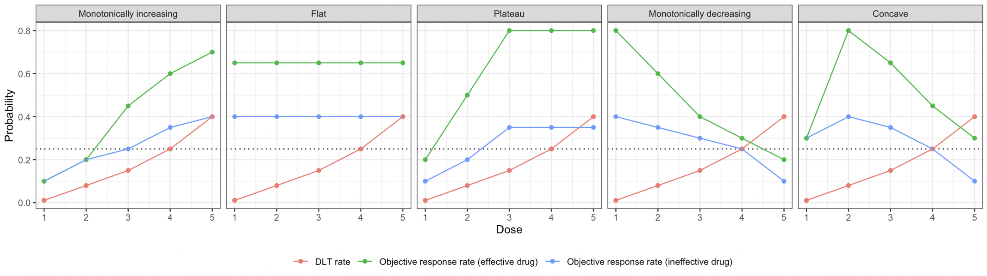
Dose-toxicity and dose-response
✸
✸
✸
✸
✸
✸ Best dose
MTD
Notes:
The 5 dose-response scenarios are monotonically increasing, flat, plateauing, monotonically decreasing, and concave. Dose-response curves in the effective and ineffective cases are shown in green and blue, and the best dose in each scenario is shown with an asterisk.
The dose-toxicity curve is constant for all scenarios, where the MTD is dose 4.

Slide 10
Metrics | Time of calculation | Possible values | Definition
Probability of Best Selection (PBS) | End of phase I | 0 to 1 | The probability that the phase I trial selected the best dose as the RP2D.
Probability of Acceptable Selection (PAS) | End of phase I | 0 to 1 | The probability that the phase I trial selected an acceptable dose as the RP2D.
F-score | End of phase II | 0 (perfectly inaccurate classification) 1 (perfectly accurate classification) | A measure of how accurately the phase I-II pipeline is able to distinguish between not only an effective and ineffective drug, but also an acceptable and unacceptable dose; selecting an acceptable dose and declaring “go” in phase II, and selecting an unacceptable dose and declaring “no-go”.
False positive rate (FPR) | End of phase II | 0 to 1 | The probability that the phase I trial selected an unacceptable dose AND the subsequent phase II declared the dose effective.
True positive rate (TPR) | End of phase II | 0 to 1 | The probability that the phase I trial selected an acceptable dose AND the subsequent phase II declared the dose effective. This can only be calculated for an effective drug.
False negative rate (FNR) | End of phase II | 0 to 1 | The probability that the phase I trial selected an acceptable dose AND the subsequent phase II failed to declare the dose effective. Equal to 1 – TPR. This can only be calculated for an effective drug.
True negative rate (TNR) | End of phase II | 0 to 1 | The probability that the phase I trial selected an unacceptable dose AND the subsequent phase II failed to declare the dose effective. Equal to 1 – FPR.
Notes:
I look at 3 primary metrics. The probability of best selection (PBS) and probability of acceptable selection (PAS) are calculated at the end of phase I. These refer to the probability that the phase I trial selects the best dose or an acceptable dose, respectively.
At the end of phase II, I look at the F-score, which is a measure capturing the trade-off between false positive and negative rates. It is commonly used in classification problems and in machine learning. Here, it translates to how accurately the phase I-II pipeline declares an effective drug as effective in phase II. I also provide the individual false positive, false negative, true positive, and true negative rates of the pipeline. So for example, a false positive means that the phase I trial selected an unacceptable dose AND the phase II then declared it effective.

Slide 11
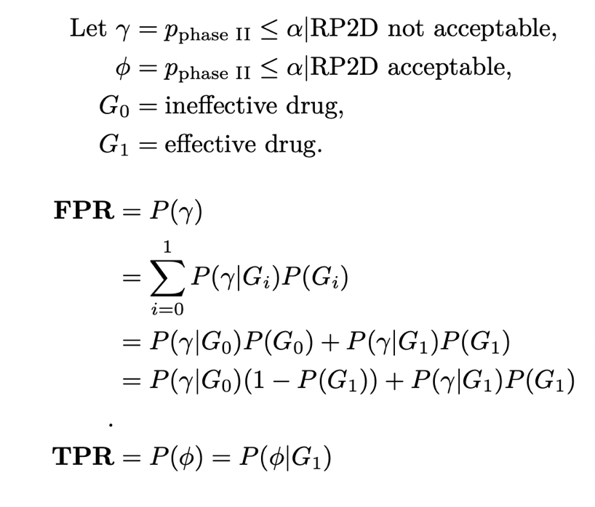
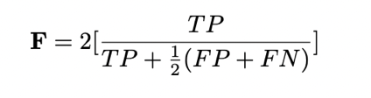
Calculation of FPR, TPR, and F-score
8
Goutte and Gaussier. A Probabilistic Interpretation of Precision, Recall and F-score, with Implication for Evaluation. 2005
Notes:
Formulation of positive and negatives rates as well as F-score are given here. In the interest of time, the false positive rate is calculated with consideration of the probability that the drug is effective, since both effective and ineffective drugs may have unacceptable doses. On the other hand, the true positive rate is calculated only when the drug is effective and the RP2D is acceptable. The false and true negative rates are calculated similarly. The F-score then gives a summary measure of the tradeoff between all these values.

Slide 12
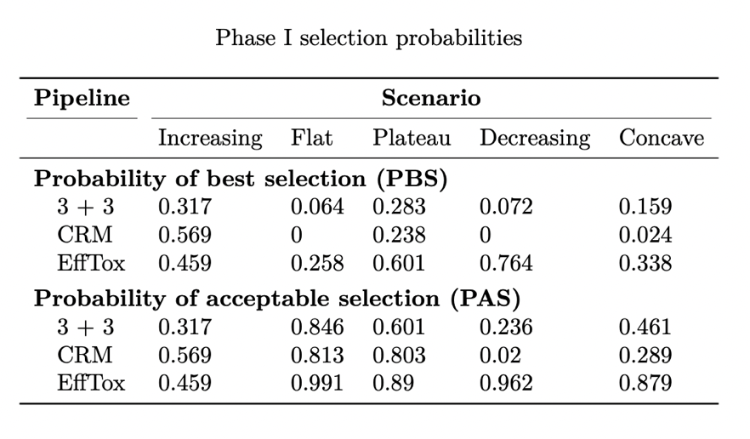
Results – Phase I dose selection
Notes:
That was a lot of setup, sos I want to focus on the most significant results.
When best dose = MTD, CRM is best
When best dose < MTD, EffTox is best
And the probability of acceptable selection can be quite high, because multiple doses may be acceptable.
You may also note that the 3+3 performs better than the CRM in some cases, and I will explain this in the next slide.

Slide 13
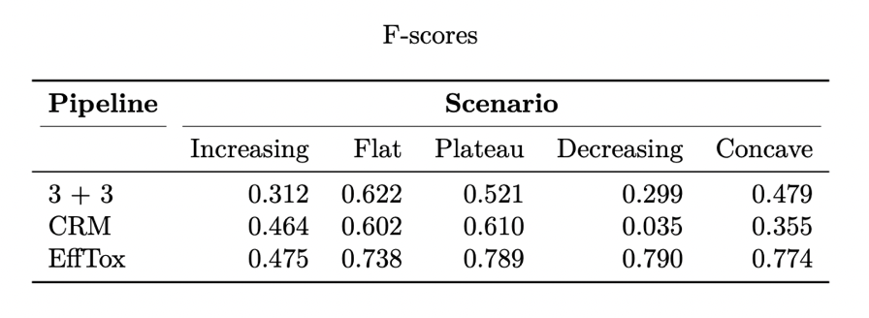
Results – F-score
After phase II
Notes:
Looking at the pipeline results. Recall that the F-score is a measure of how accurately the pipeline declared a truly effective dose as “promising” at the end of phase II, a high F-score is good. EffTox has the best performance across all 5 scenarios, which is likely because it considers efficacy as well as toxicity. But I want to highlight 3 cases where the 3+3 outperforms the CRM – flat, decreasing, and concave.
The best dose is below the MTD for these scenarios. Since the CRM more accurately selects the MTD as has been shown many times in the literature, and the 3+3 can select a lower dose more often, the 3+3 will happen to select the best dose more often than the CRM.
Lastly, I want to note that the false positive rates are much higher than the nominal phase II type I error rate, and the true positive rate can be much lower than nominal phase II power. This is again because these are calculated for the pipeline and are therefore a function of the phase I dose selection.

Slide 14
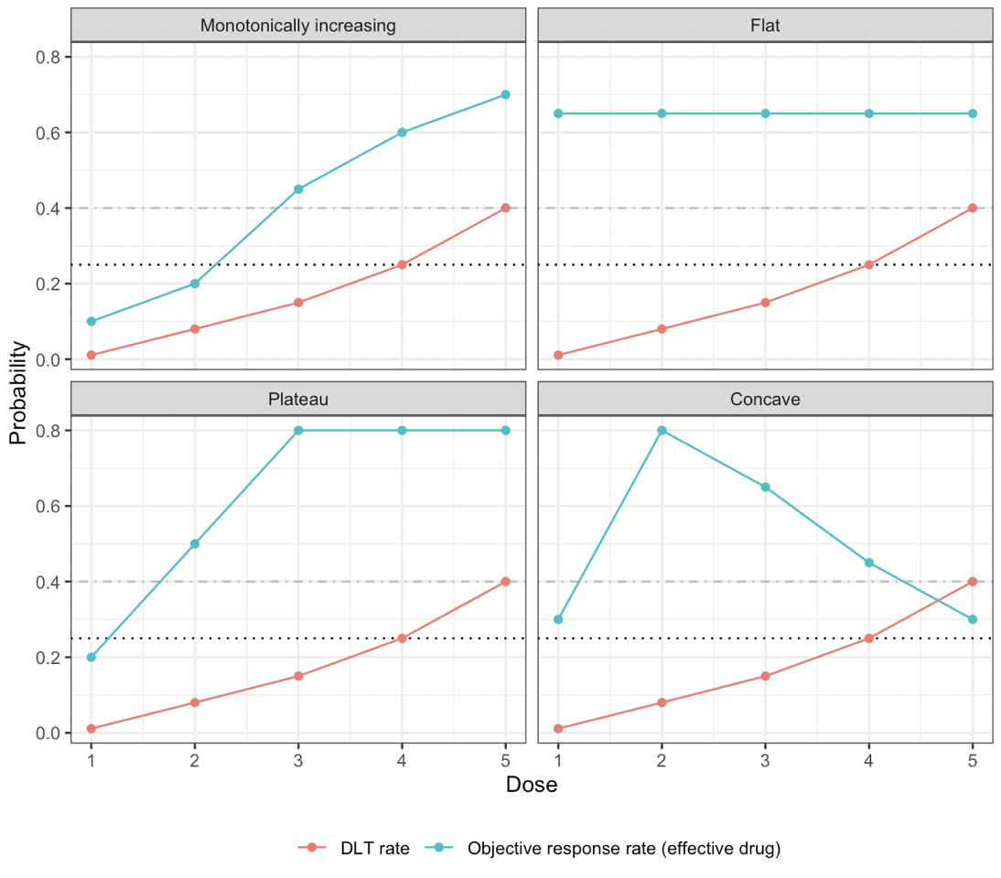
Results – Increasing vs. Flat
Notes:
Looking at the pipeline results. Recall that the F-score is a measure of how accurately the pipeline declared a truly effective dose as “promising” at the end of phase II, a high F-score is good. EffTox has the best performance across all 5 scenarios, which is likely because it considers efficacy as well as toxicity. But I want to highlight 3 cases where the 3+3 outperforms the CRM – flat, decreasing, and concave.
The best dose is below the MTD for these scenarios. Since the CRM more accurately selects the MTD as has been shown many times in the literature, and the 3+3 can select a lower dose more often, the 3+3 will happen to select the best dose more often than the CRM.
Lastly, I want to note that the false positive rates are much higher than the nominal phase II type I error rate, and the true positive rate can be much lower than nominal phase II power. This is again because these are calculated for the pipeline and are therefore a function of the phase I dose selection.

Slide 15
Results – Plateau vs. Concave
Notes:
Looking at the pipeline results. Recall that the F-score is a measure of how accurately the pipeline declared a truly effective dose as “promising” at the end of phase II, a high F-score is good. EffTox has the best performance across all 5 scenarios, which is likely because it considers efficacy as well as toxicity. But I want to highlight 3 cases where the 3+3 outperforms the CRM – flat, decreasing, and concave.
The best dose is below the MTD for these scenarios. Since the CRM more accurately selects the MTD as has been shown many times in the literature, and the 3+3 can select a lower dose more often, the 3+3 will happen to select the best dose more often than the CRM.
Lastly, I want to note that the false positive rates are much higher than the nominal phase II type I error rate, and the true positive rate can be much lower than nominal phase II power. This is again because these are calculated for the pipeline and are therefore a function of the phase I dose selection.

Slide 16
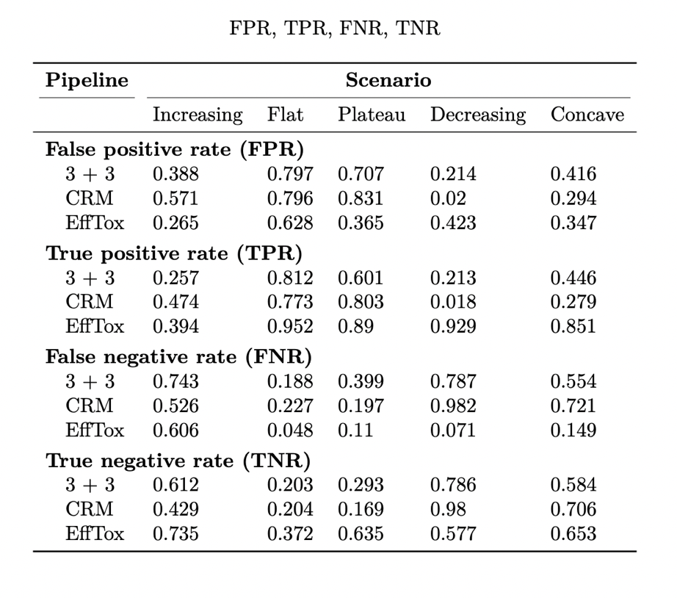
Results – Metric preference
The F-score here weights all measures equally, but if we care more about lowering the FPR than we do increasing the TPR, then a mathematical adjustment can account for this.
Notes:
Looking at the pipeline results. Recall that the F-score is a measure of how accurately the pipeline declared a truly effective dose as “promising” at the end of phase II, a high F-score is good. EffTox has the best performance across all 5 scenarios, which is likely because it considers efficacy as well as toxicity. But I want to highlight 3 cases where the 3+3 outperforms the CRM – flat, decreasing, and concave.
The best dose is below the MTD for these scenarios. Since the CRM more accurately selects the MTD as has been shown many times in the literature, and the 3+3 can select a lower dose more often, the 3+3 will happen to select the best dose more often than the CRM.
Lastly, I want to note that the false positive rates are much higher than the nominal phase II type I error rate, and the true positive rate can be much lower than nominal phase II power. This is again because these are calculated for the pipeline and are therefore a function of the phase I dose selection.

Slide 17
Limitations, conclusions, and future work
Limitations
One phase II design with a binary outcome (response rate)
No phase II toxicity monitoring
Fixed dose-response curves
Conclusions
Go/no-go may be sensitive to
The underlying dose-efficacy curve
The phase I design
Size of the effect? Number of effective doses?
This is preliminary work, but demonstrates that there are multiple drug and phase I design characteristics that impact future development outcomes that may be important to consider in early phase clinical trial design.
Simulations can be a powerful – and even simply – way to inform clinical trial design.
Notes:
There are several limitations worth noting. First I consider only one phase II design, and my primary endpoint is response rate. Other designs and time-to-event measures like progression-free survival are also worth considering. I also did not incorporate phase II toxicity monitoring, which could have improved false positive rates.
I used fixed dose-response curves, and results may be more robust with parametric curves that are generated for each simulation. That being said, it may be also that the size of the treatment effect, and the number of effective doses will affect phase II outcomes, so future work may look at this as well.
Still, this study was able to provide some evidence that phase II go/no-go decisions may be sensitive to both the preceding phase I design and the underlying dose-response relationship.
So though this is preliminary work, it demonstrates that there are multiple drug and phase I design characteristics that can impact future development outcomes. Especially because we saw that no single phase I design performs best for all scenarios, so consideration of potential future trial outcomes in planning a present trial may be really pertinent. And in this era of computing and data-driven analysis, simulations can be a powerful and even simple way to design clinical trials.

Slide 18


Thank you!
@VanderbeekAM
/alyssamv
Notes:
Finally, I would like to acknowledge Kuen Cheung at Columbia University for his guidance in the study design and metrics assessments.
Thank you.

Slide 19
References
Wong CH, Siah KW, Lo AW. Estimation of clinical trial success rates and related parameters. Biostatistics. 2018.
De Ridder F. Predicting the outcome of phase III trials using phase II data: a case study of clinical trial simulation in late stage drug development. Basic Clinical Pharmacology Toxicology. 2005.
Jiang K. Optmial Sample Sizes and Go/No-Go Decisions for Phase II/III Development Programs Based on Probability of Success. Statistics in Biopharmaceutical Research. 2011.
Gotte H, Schuler A, Kirchner M, Kieser M. Sample size planning for phase II trials based on success probabilities for phase III. Pharmaceutical Statistics. 2015.
Conaway MR, Petroni GR. The Impact of Early-Phase Trial Design in the Drug Development Process. Clinical Cancer Research. 2019.
Cheung, YK. Dose Finding by the Continual Reassessment Method. CRC Press. 2011.
Thall PF, Cook JD. Dose-Finding Based on Efficacy-Toxicity Trade-Offs. Biometrics. 2004.
Goutte C, Gaussier E. A Probabilistic Interpretation of Precision, Recall and F-score, with Implication for Evaluation. European Conference on Information Retrieval. 2005.

